Slide 1
i - Recovery
i-Recovery addresses all the major functional areas of Health Care. i-Recovery provides the benefits of streamlined operations, enhanced administration control, improved response to patient care and cost control. it reduces patient’s waiting time by smooth flow of information and provides house keeping of medical records such as patient’s history, case, diagnostic details and prescriptions ordered by Providers.

Slide 2
i - Recovery Functions:
i - Recovery Partners
i - Recovery Landscape
i - Recovery Health Monitoring
i - Recovery Mobility Services
i - Recovery Functions
i - Recovery Functional Scope
i - Recovery Actions
i - Recovery Activities
i - Recovery Modules
i - Recovery Cycles
i - Recovery Features

Slide 3


i-Recovery Partners :
Patient
i-Recovery
Provider

Slide 4
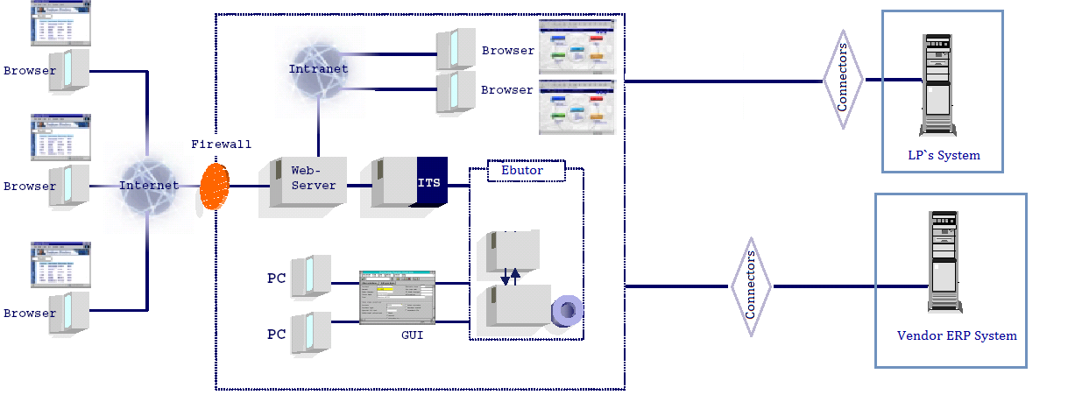
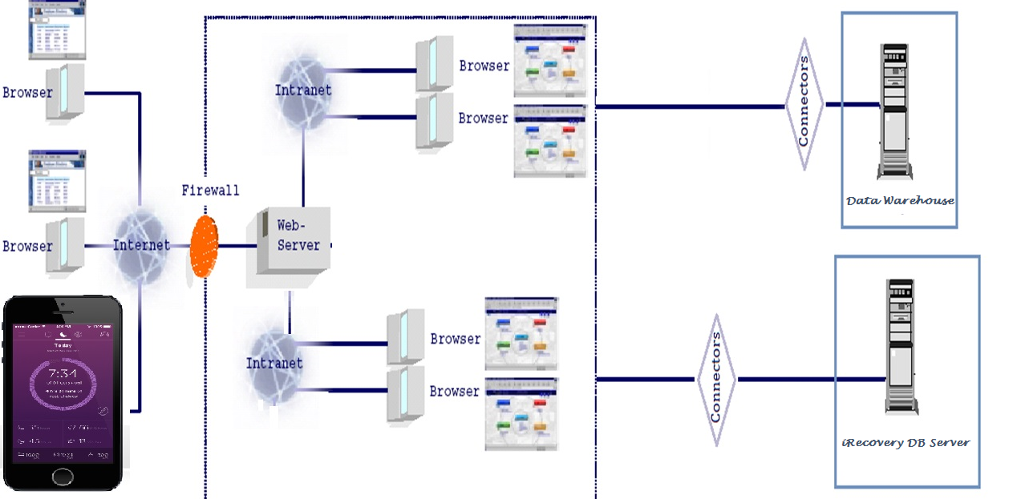
Landscape diagram

Slide 5
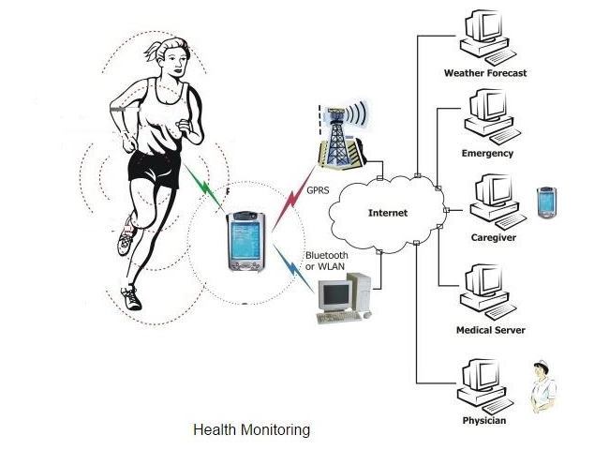
i-Recovery Health Monitoring

Slide 6
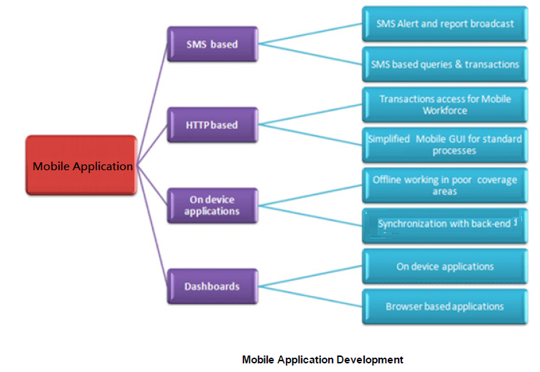
i-Recovery Mobility Services:

Slide 7
i-Recovery Mobility Services:
Native Application Development on IOS, Android , Windows , Blackberry.
Common Device Application Development in HTML
Integration with Enterprise Applications
Integration with Application development Technologies like .NET, JAVA
Web Services Creation

Slide 8
i- Recovery Functions:
Appointments
Pharmacy
PHQ
Provider Activities
Assessments
Patient Activities
i -Recovery
Interventions
Emergency
Journals
Insurance
Patient Intake
Registrations

Slide 9
i-Recovery Functional Scope:
Appointments
Health Questionnaire - PHQ
Assessments
Interventions
Journals
Patient Intake Process
Registration
Insurance
Emergency
Patient Activities
Provider Activities
Provider Schedules
Pharmacy
Subscriber Details
Alerts & Follow-ups
Survey
Reports

Slide 10
i-Recovery Activities:
Analytics & Reports
Business Information
WareHouse
Emergency
Appointments Scheduling
Alerts, Mails & Messages
Patient Health Questionnaire
Policies
Assessments
i-Recovery
Interventions
Insurance
inventory management
Provider Recomandations
Journals
Provider Calendar
Patient Past Health History
Patient Activities
Provider Activities

Slide 11
i-Recovery Process :
i- Recovery
Patient
Provider
Assessments
Interventions
Journals-Meds
Care team

Slide 12

i-Recovery Cycle:
Appointments
Patient Intake
Assessments
Interventions
Patient Feed Back
Journals
Patient Recovery
Scale

Slide 13
i -Recovery Features:
• Rugged and Reliable with easy configure, customize & upgrade options
• Ease in modification in case of changes in business process
• Preserves data security and integrity. Secure from unauthorized access

Slide 14
i-Recovery Features:
Easily customizable for client’s specific needs
User-friendly interface
Easily upgradeable and modifiable in case of changes in business process
Preserves data security and integrity
Rugged and reliable

Slide 15
Bridging Gaps between
Patient & Providers….!
Thank You!

